Slide 1

IOT Based Poultry Environment Monitoring System
\

Slide 2


Poultry Environment Monitoring System
Automated monitoring and control of temperature/humidity via sensors and Wi-Fi connectivity, optimizing poultry welfare and productivity by adjusting environmental conditions autonomously based on preset thresholds.

Slide 3


C.V Raman Global University Bhubaneswar, Odisha.
ABOUT US
Pannel Member
Name : Rana Sujeet Kumar
Name :Bibhu Prashad
Name :Sibom sahu
Name-Prashant sir

Slide 4



Introduction
Introduction:
Welcome to our presentation on "Revolutionizing Poultry Farming: Smart Environmental Control with IoT". In today's rapidly evolving agricultural landscape, the integration of cutting-edge technologies is reshaping traditional farming practices, and nowhere is this more evident than in the poultry industry.
Nigeria boasts a thriving poultry sector, contributing significantly to the nation's agricultural GDP.
However, despite its economic importance, the sector faces numerous challenges, including high production costs, limited automation, and inefficient environmental control within poultry houses. Recognizing these challenges, our research endeavors to harness the power of IoT to transform poultry farming into a smarter, more efficient, and sustainable endeavor.

Slide 5
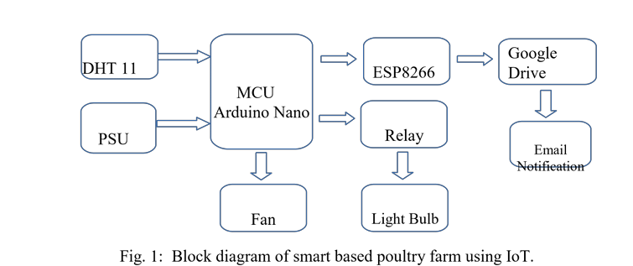

Literature Review

Slide 6
Patent Search
S.NO | Title | Research Paper/SCI /C/B/D | Year | Challenges | Objectives
1 | Smart Poultry Farming Using Internet of Things (IoT) | C | 2023 | High production costs, lack of automation | To automate environmental control in poultry farming
2 | IoT-Based Smart Control System for Poultry Farming | SCI | TBD | Climate constraints, manual monitoring | To monitor and control environmental parameters in real-time
3 | Smart Farm Monitoring Using Wireless Sensor Network | B | 2016 | Limited connectivity, data analysis challenges | To monitor poultry farms using wireless sensor networks
4 | PLC-Based Poultry Automation System | D | 2014 | Automation complexity, system integration issues | To automate various poultry farming processes
5 | Internet-Based Smart Poultry Farm | C | 2015 | Connectivity issues, data security concerns | To enable remote monitoring and management of poultry farms
6 | Integrated Solution Using WSN and GPRS Network | D | 2016 | Network reliability, sensor calibration | To develop an integrated solution for poultry farm monitoring

Slide 7
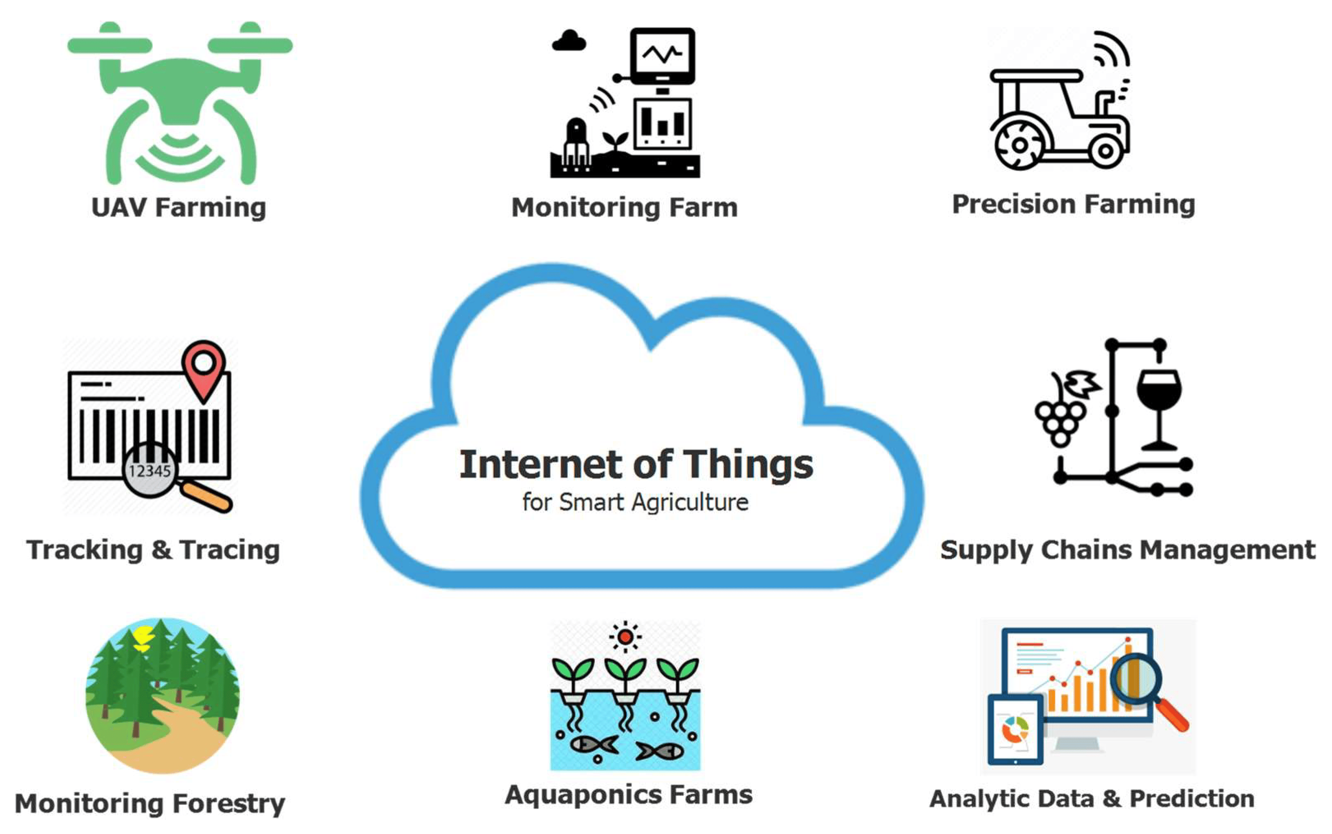
(Note: "SCI" denotes papers indexed in scientific citation databases, "C" denotes conference papers, "B" denotes journal papers, and "D" denotes papers from other sources.)
Architecture of working model text here

Slide 8
References
1. R.R Dinrifo, E.O Abatan. "Smart Poultry Farming Using IoT." Laspotech Journal of Scientific, Engineering and Technology Research. 2023.
2. Siwakorn Jindarat, Pongpisitt Wuttidittachotti. "Smart Farm Monitoring Using Wireless Sensor Network." IEEE International Conference on Computer, Communication, and Control Technology. 2015.
3. Rupesh I. Muttha et al. "PLC-Based Poultry Automation System." Int. J. Sci. Res. 2014.
4. Sravanth Goud, Abraham Sudharson. "Internet-Based Smart Poultry Farm." Indian Journal of Science and Technology. 2015.
5. Sonavane S. S., D. Y. Patil. "Smart Poultry Farm: Integrated Solution Using WSN and GPRS." Int. J. Adv. Res. Comput. Eng. & Technol. 2016.
6. Ugwuoke C. Uche et al. "Management of Poultry Farms for Food Security in Enugu State, Nigeria." G.J.B.A.H.S. 2017.

Slide 9
THANK YOU!

